Slide 1
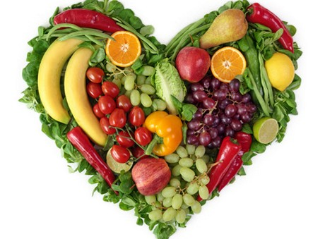
Food As Medicine
Simon Glantz

Slide 2
Food As Medicine
Disclaimer
Pseudoscience – is bad science. It is not the same thing as new science.
In science there is always a mainstream view and a number of dissenting bodies. Many of the dissenting bodies are as qualified and use methods as rigorous as mainstream scientists.
Without different theories we would never make progress! The Earth is not flat!
Quacks and snake oil salesmen have made it more difficult for scientists who present new findings to the scientific community to be taken seriously
Scientific dogma is very common, especially in the light of change. It is human nature to get attached to a particular theory. Many scientists have invested entire careers (and therefore their sense of identify) in their work. When new research comes to light that challenges existing views, it can cause friction
We are in an era of rapid change and many well established theories are being questioned. It is a very exciting time which offers much hope in light of the epidemic of diseases we see today.
What I’m going to talk about today is not “the truth”. I don’t claim to know the truth. I intend to share with you some of the cutting edge research in nutritional science, much of which has come from very highly qualified doctors and scientists from many different countries.

Slide 3
Food As Medicine
About Me
I trained as a nutritionist 9 years ago
What motivated me to do this was the state of health of my close family, especially my father
I had also suffered from a neurological disorder since childhood with bouts of uncontrollable nervous tics, extreme anxiety and nervous exhaustion
I thought there had to be more we could do than just manage symptoms
It has changed my life

Slide 4
Food As Medicine
“Let thy food be thy medicine and thy medicine be thy food”
-Hippocrates (Father of medicine)
Who was Hippocrates?
Hippocrates was a Greek physician of the Age of Pericles (Classical Greece), and is considered one of the most outstanding figures in the history of medicine. He is referred to as the "Father of Early Medicine“ in recognition of his lasting contributions to the field

Slide 5
Food As Medicine
For thousands of years, food was used to heal the sick.
Many cultures around the world have also long held this belief, e.g. Ayurveda, TCM, Traditional Tibetan medicine and many others.
In the last century and especially in the last few decades, the exact opposite trend can be observed, especially in the west.
Today, the majority of people have come to view food as merely a source of energy/fuel or simply…

Slide 7
Food As Pleasure
Do I have to eat bowls of twigs to be healthy?
Nutritional value and pleasure are not mutually exclusive!
More on that later…

Slide 8
What Is A Medicine/Drug?

Slide 9
What Is A Medicine/Drug?
Any chemical compound used in the treatment, or prevention of disease or other abnormal condition.
A substance used recreationally for its effects on the central nervous system, such as a narcotic.
A chemical substance that affects the processes of the mind or body.

Slide 10
What Is A Medicine/Drug?
Antipyretics
Antidepressants
Antipsychotics
Analgesics
Antibiotics
Antiseptic
Mood Stabilisers
Hormones
Contraceptives
Stimulants
Tranquilisers
Statins

Slide 11
What Is A Medicine/Drug?
Typically, drugs are one directional. For example:
Antipyretics reduce fever
Blood pressure medication lowers blood pressure
Statins lower cholesterol
This is fine for getting somebody out of trouble but it is far from ideal as it is very hard to get the precise dosage to maintain homeostasis.
The body produces different compounds in differing quantities and at different times depending on the needs of the body. Some compounds will raise your blood pressure. Others will lower it.

Slide 12
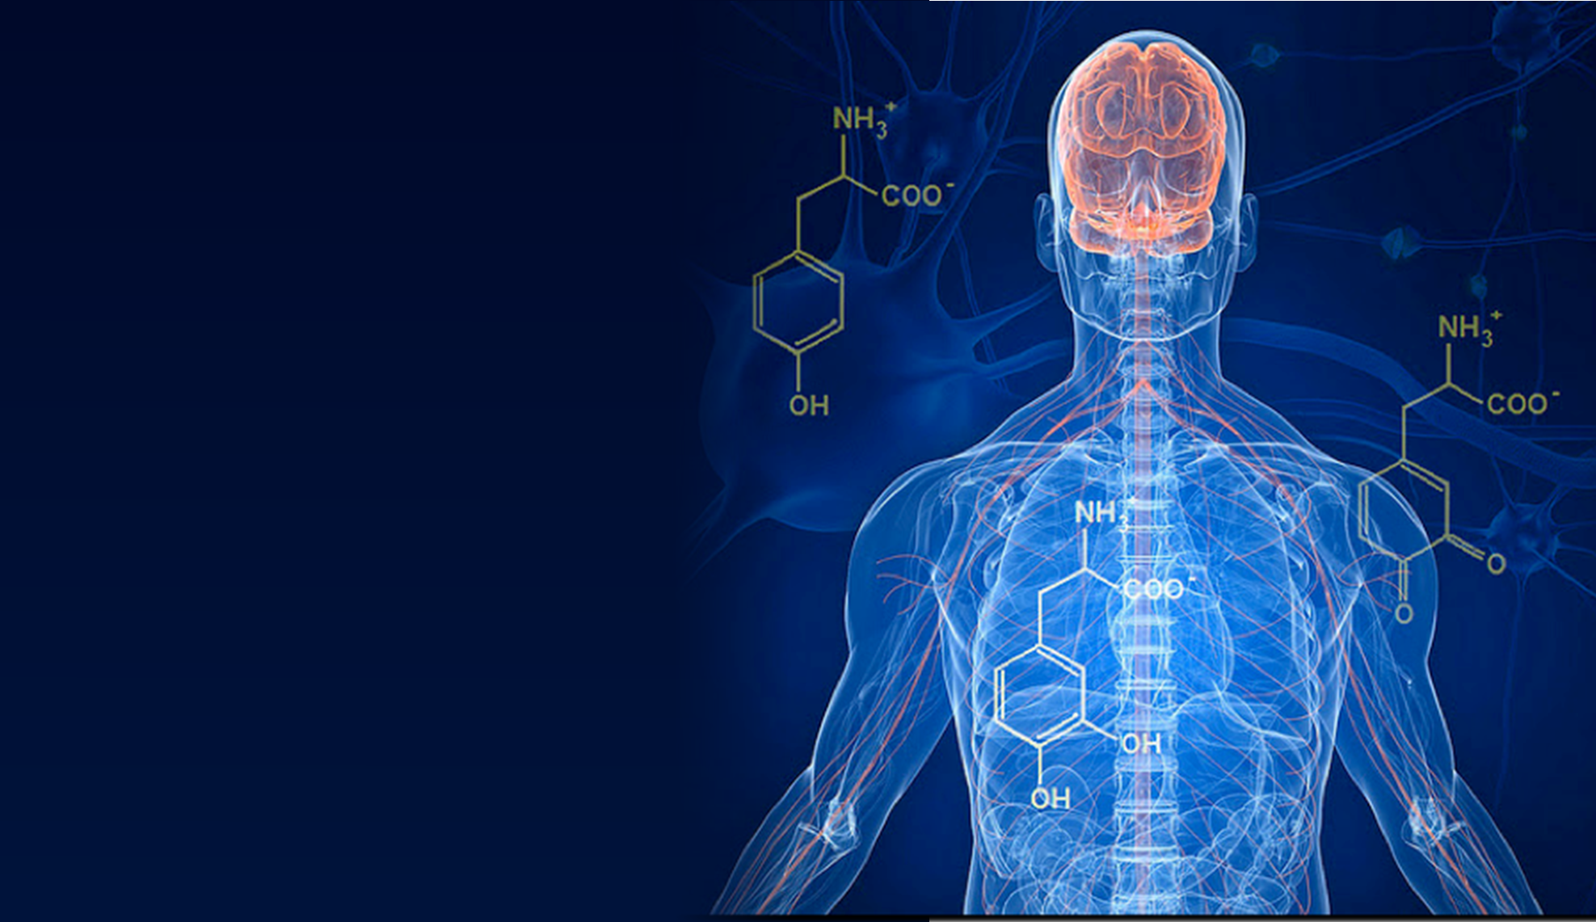
What Is A Medicine /Drug?
By far the biggest pharmacy that exists is our own body
The body makes thousands of different drugs on a daily basis
These chemical compounds are responsible for keeping us alive by allowing our body to constantly adapt and recalibrate

Slide 13
Homeostasis

Slide 14
Homeostasis
Homeostasis is the property of a system within an organism in which a variable, such as the concentration of a substance in solution, is actively regulated to remain very nearly constant. Examples of homeostasis include the regulation of body temperature, the pH of extracellular fluid, or the concentrations of sodium or potassium ions, as well as that of glucose in the blood plasma

Slide 15
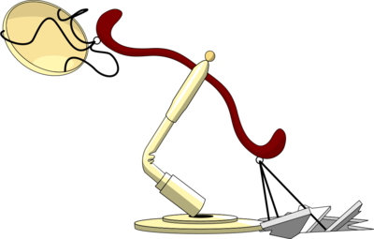
Homeostasis
Sometimes things go wrong, and the body is not able to effectively maintain homeostasis.
The body’s own “pharmacy” is unable to produce enough drugs to keep us in balance.
This is where certain drugs can be lifesaving

Slide 16
Examples Of Drugs
SSRI – Selective serotonin reuptake inhibitor
Increases concentrations of serotonin in certain areas of the brain
Serotonin is a neurotransmitter associated with feelings of calm and wellbeing.
It is implicated in many very important bodily functions such as sleep, hunger, mood, anxiety, depression, wound healing, bone health, blood clotting, sexual function.

Slide 17
Natural Serotonin Boosters
Are there any natural substances that can raise serotonin levels in a meaningful way?
Tryptophan
An amino acid found in foods such as poultry, eggs, dairy, fish, nuts and seeds.
Tryptophan gets converted into serotonin in the following manner:

Slide 18
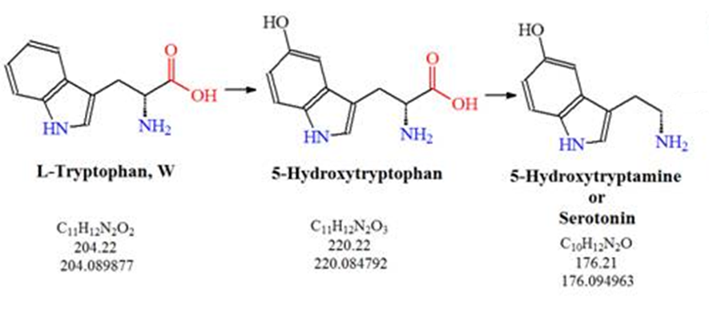
Tryptophan => Serotonin

Slide 19
Tryptophan => Serotonin
This conversion takes place thanks to enzymes

Slide 20
Enzymes – What Are They?
The creation of chemical compounds in the body is dependent on enzymes
Enzymes are biological catalysts
Enzymes initiate and accelerate chemical reactions inside over 90 trillion cells
Enzymes are involved in digestion, energy production, creation of hormones and other important secretions, help destroy damaged cells, important part of the immune system, etc.
Without enzymes we would die!

Slide 21
Enzymes
Our enzymes are dependent on specific nutrients
If our diet does not provide all of the key nutrients, we cannot make enough enzymes

Slide 22
Tryptophan => Serotonin
Many nutrients are necessary in order for this enzymatic conversion to take place:
B Vitamins, especially:
B6 (P5P)
B1 (thiamine)
B2 (riboflavin)
B9 (folate)
Vitamin D
Selenium
Zinc
Magnesium

Slide 23
Enzymes
The amount of enzymes required (and therefore nutrients to make them) is directly proportionate to the amount of stress we are under.

Slide 24
Tryptophan => Serotonin
1 in 11 adults in Britain are currently prescribed SSRI medication
Prescription of antidepressant medication is more common when a person has been under significant stress
Doctors neither have enough time or are trained to enquire about the patient’s nutritional status

Slide 25
Other Examples Of Drugs
Diazepam – Benzodiazepine / tranquiliser
Used to treat major anxiety disorder, insomnia, alcohol withdrawal, muscle spasms, etc.
Increases concentrations of and sensitivity to GABA
What is GABA?

Slide 26
GABA
GABA is one of the most abundant neurotransmitter in the body, along with glutamate.
It is the chief inhibitory neurotransmitter, responsible for reducing neuronal excitability - It calms you down!
It is especially present in the cerebral cortex and has a profound effect on how thoughts and sensations are processed
GABA is made in the cells of the brain, where it is converted from glutamate thanks to the…
GAD Enzyme
Balances GABA and glutamate levels

Slide 27
GABA / Glutamate
Glutamate is the primary excitatory neurotransmitter.
GABA and glutamate have an inverse relationship. They work like the break and accelerator.
Too much GABA is heavily sedating (drunk) If too much glutamate is present, the result can be extreme:
Too much glutamate causes:
Anxiety
Restlessness
Nervous tensions
Irritability
Insomnia
Racing thoughts
Poor stress tolerance
etc.

Slide 28
GABA & Nutrition
How does nutrition affect the production of GABA?
In order to produce enough of the GAD enzyme, several nutrients are required (this list is not exhaustive)
B6 (Pyridoxal 5’ Phosphate)
Magnesium
Zinc
Taurine
L-theanine (tea is a good source of this amino acid)
Organic lithium
Research into gut bacteria now shows that the presence of the correct strains of bacteria also strongly effects the GAD enzyme

Slide 29
Nutrition & Cardiovascular Health
Heart disease and stroke
Risk is associated with degree of arterial plaque and inflammation
Nutrients which are protective:
Vitamin C
Magnesium
Vitamin K2
Vitamin D3
Antioxidant status, CoQ10
Correct balance of fatty acids and good fats

Slide 30
Drugs Versus Nutrients
Drugs are often intended to affect a single biological pathway
For example there are drugs to:
Lower blood pressure
Lower blood sugar
Block adrenaline
Increase serotonin
Decrease dopamine
Kill certain types of bacteria

Slide 31
Drugs Versus Nutrients
Nutrients exert an effect on multiple biological pathways simultaneously
For example, zinc:
Zinc plays a crucial role in proper immune system function
Acts as an antioxidant to reduce risks of free radical induced damage to cells
Plays a vital role in hormone balance, especially stress hormones
Helps balance blood sugar
Promotes health of cardiovascular system
Increases fertility in men and women
Promotes good eye health
Supports liver health
Support muscle growth and repair

Slide 32
Zinc
Good food sources of zinc include:
Red meat (especially lamb, game and grass fed beef)
Sea food (oysters are very high in zinc)
Pumpkin seeds
Chickpeas
Cacao
Cashews
Kale
Spinach

Slide 33
Magnesium
Magnesium:
Another crucial mineral for our health. It is involved in hundreds of biochemical reactions in the body. Magnesium deficiency is dramatically under-diagnosed as it doesn’t show up on blood tests!
Plays a vital role in the production of cellular energy ATP
Crucial to the formation of certain proteins from amino acids
Helps protect the integrity of our DNA
Is involved in muscle cell movement
Is very important for healthy nervous system function
Fights depression
Helps type II diabetes
Lowers blood pressure
Is anti-inflammatory
Can help reduce migraines

Slide 34
Magnesium
Good food sources of magnesium include:
Spinach, chard, kale
Cacao
Pumpkin seeds
Almonds
Black beans
Avocado
Figs
Bananas

Slide 35
Phytochemicals
Mushrooms contain polysaccharides (a type of sugar) which highly beneficial to the immune system of mammals
Polysaccharides in mushrooms have been shown to increase the number of natural killer (NK) cells and T-cells, which help protect the body from infectious disease and malignancy.
Berries
Rich source of antioxidants which protect and even help to repair damaged DNA as well as protecting cholesterol from oxidation and reducing risk of heart disease
Various nutrients in berries have shown to improve cognitive function and memory

Slide 36
Phytochemicals - Adaptogens
In addition, there are literally thousands of medicinal herbs used throughout the world
Many of these herbs contain powerful phytochemicals which can improve health
There is one class of medicinal plants which are especially beneficial. In TCM these are called the “superior tonic herbs”.
Ginseng, Maca, Cordyceps, Reishi mushroom, Astragalus, Shisandra, Chaga mushroom are a few examples.
Adaptogens are bi-directional and affect multiple systems simultaneously. They work with the body, enhancing the body’s innate homeostatic mechanisms.
Their administration results in stabilization of physiological processes and the promotion of homeostasis.
Adaptogens strengthen the immune response to infectious agents yet reduce symptoms of auto-immunity and inflammation.
They improve the body’s resistance to stress.
They improve the functioning of major organs
Tonic herbs are non toxic and can be consumed daily to help prevent disease and increase wellbeing.
In China, these herbs are actually eaten in soups and stews and are considered food

Slide 37
Fat – Is It Really That Bad For Us?
Demonisation of fat and the low fat diet
Ancel Keys
Researcher who claimed that heart disease is associated with fat intake
Seven Countries Study
First multicountry epidemiological study into relationship between lifestyle, diet, coronary heart disease and stroke in different populations
He started out with 22 countries, but not all of the data didn’t support his theory and so he discarded the data from those countries who didn’t fit the model

Slide 38
Fat
Diets of the people with the lowest incidence of heart disease in the world
Massai of Kenya and Tanzania Diet primarily consists of:
Meat
Milk
Blood
Butter
66% of their calories come from saturated fat

Slide 39
Fat
Diets of the people with the lowest incidence of heart disease in the world
Inuit (Eskimos) Diet primarily consists of:
Arctic Whale meat and blubber
75% of their calories come from
saturated fat

Slide 40
Fat
Diets of the people with the lowest incidence of heart disease in the world
Rendille of Kalsut dessert of Kenya Diet primarily consists of:
Camel milk and meat
Banjo (Camel milk and blood)
63% of their calories come from saturated fat

Slide 41
Fat
Diets of the people with the lowest incidence of heart disease in the world
French
Diet is rich in:
Butter
Cheese
Animal fats
40% of their calories come from
saturated fat in some regions

Slide 42
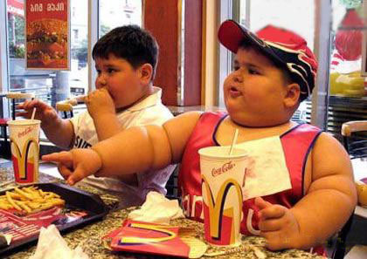
Nutrition & Cardiovascular Health
In the United States, about 610, 000 people diet every year from heart disease (1 in 4 deaths)
America
A considerable proportion of dietary calories
are derived from:
Grains
Sugar
Trans fats
14% of their calories come from
saturated fat

Slide 43
Nutrition & Disease
The same trends seen in heart disease also apply to cancer, diabetes and other chronic diseases
The exact causes of these illnesses continue to be debated amongst experts, but there is a clear correlation with diet.

Slide 44
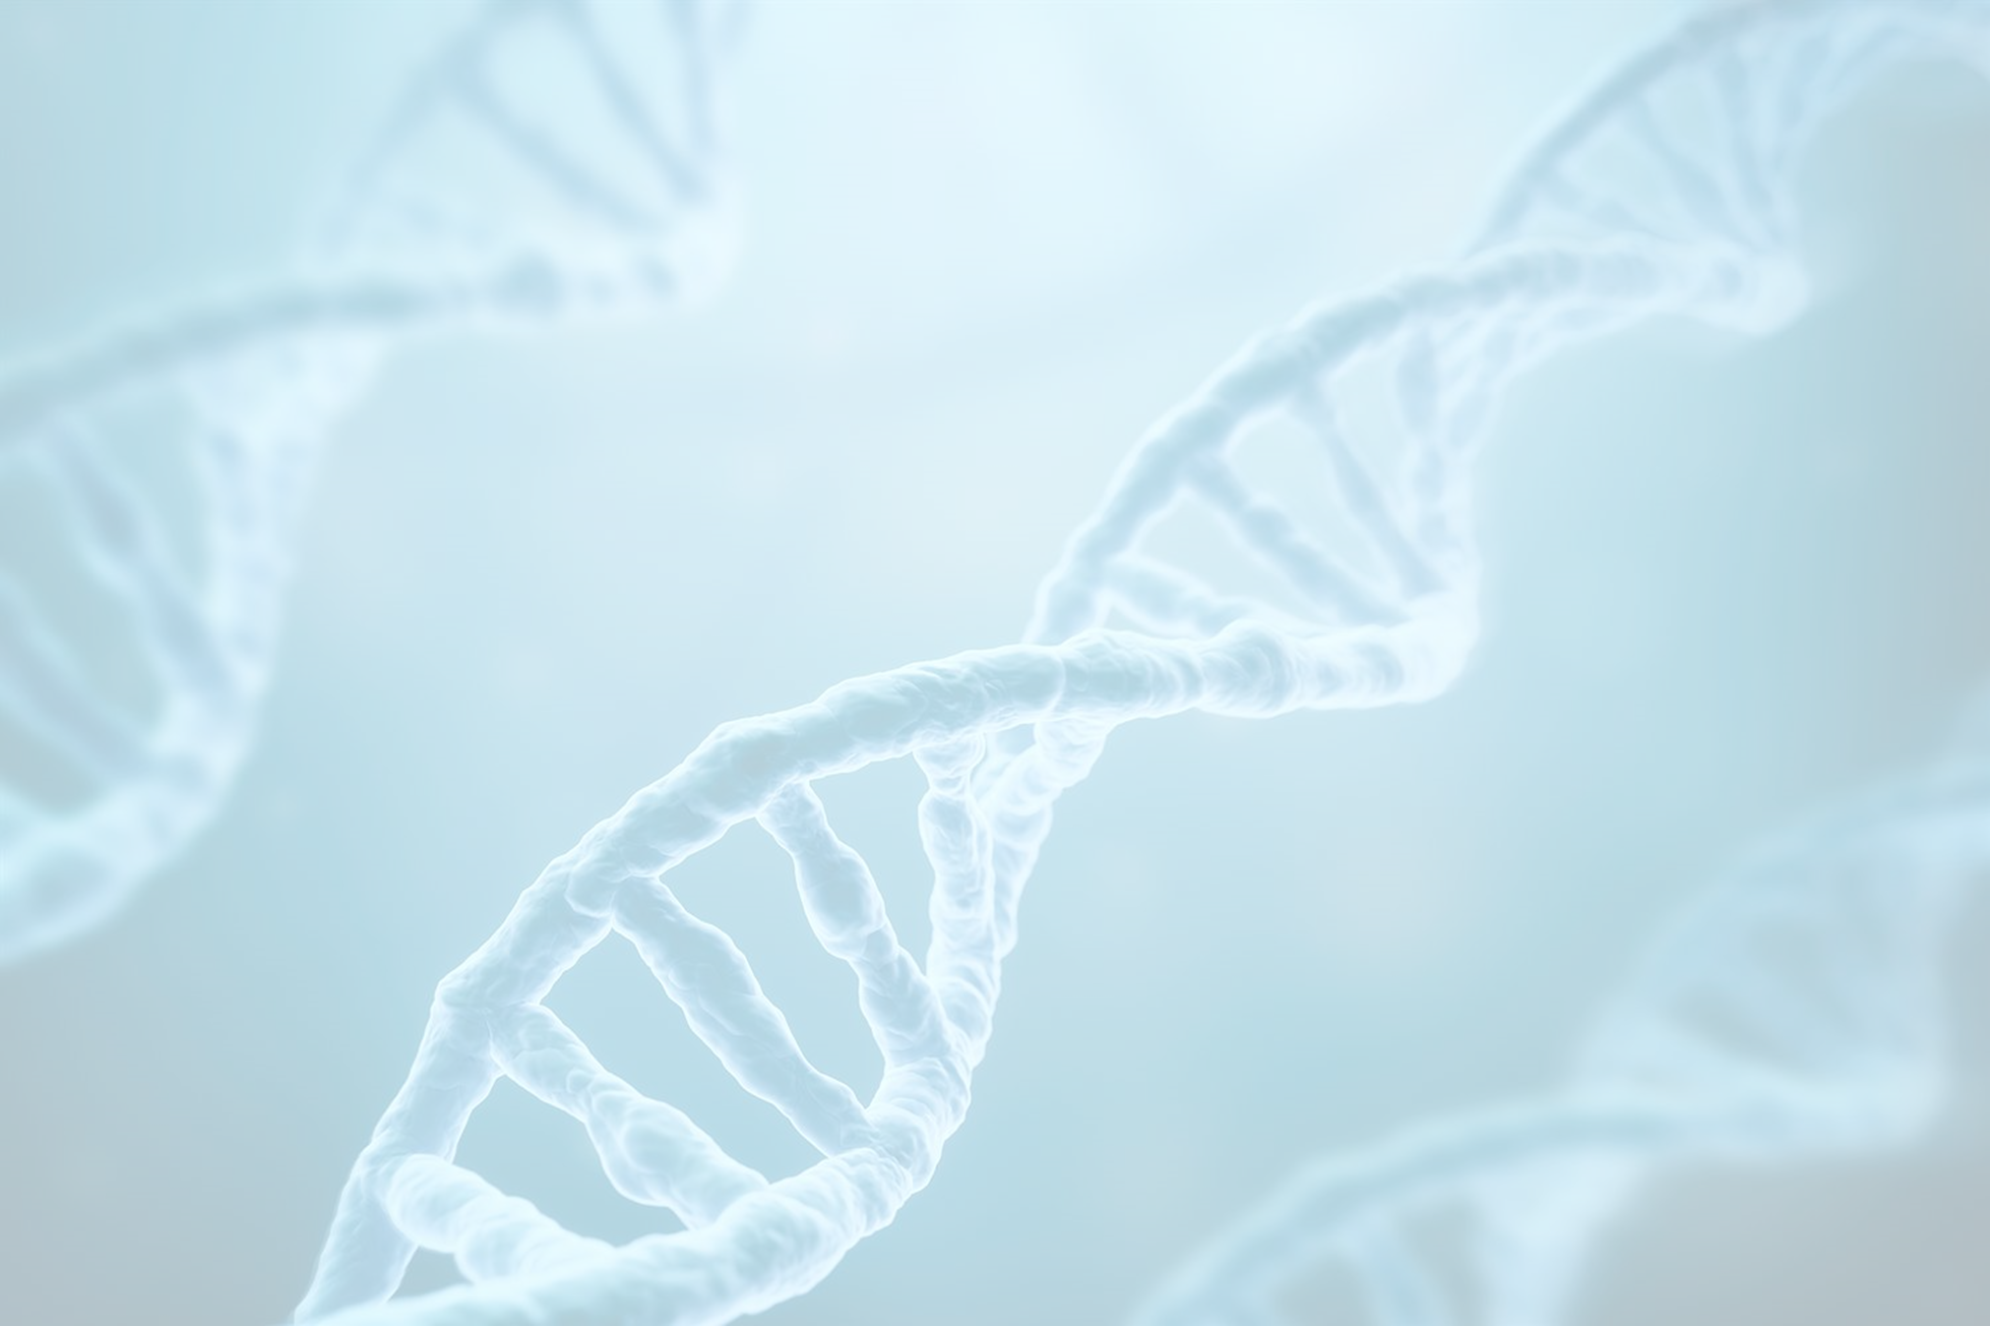
Genes, Nutrition & Disease
Until recently it was believed our genes were highly predictive of disease. If you were genetically predisposed to certain diseases, for example the BRCA1, BRCA2, TP53, PALB2 breast cancer genes, then it was believed that there was not very much you could do about.
New research is now demonstrating that this is largely false.
Only a very small number of cancers, for example, are actually genetic.
A far greater factor is environment.
A significant portion of our DNA is highly configurable depending on the environment.

Slide 45
Epigenetics
Sun tan. Upon exposure to sunlight, genes are switched on insourcing melanocytes to produce more melanin in the epidermis of the skin.
Thousands of genetic “switches” are flicked on and off on a daily basis.
Some switches are much more conducive to health. Others have a much stronger correlation with disease.
Exercise and nutrition are two of the biggest factors that determine whether you activate healthy genes or disease promoting genes.

Slide 46
Epigenetics
Many factors influence the cellular environment and therefore our DNA:
Air
Water
Presence of exogenous toxin and metabolic waste products
Nutritional status / mineral content of a person
Stress

Slide 47
Epigenetics
Summary
You have far greater control of your health than previously believed.
You can reduce the risk of major chronic diseases, including heart disease, stroke, diabetes and even cancer through adequate nutrition.
The natural world offers us enormous potential!

Slide 48
Organic Versus Conventional Produce
Is organic just another money-making scam?
The short answer is NO
According to some recent studies organic product sold in supermarkets is unlikely to contain a lot more nutrition than conventional produce.
However, organic produce from small farms has shown to have significantly higher levels of major minerals and vitamins.
How is this possible?

Slide 49
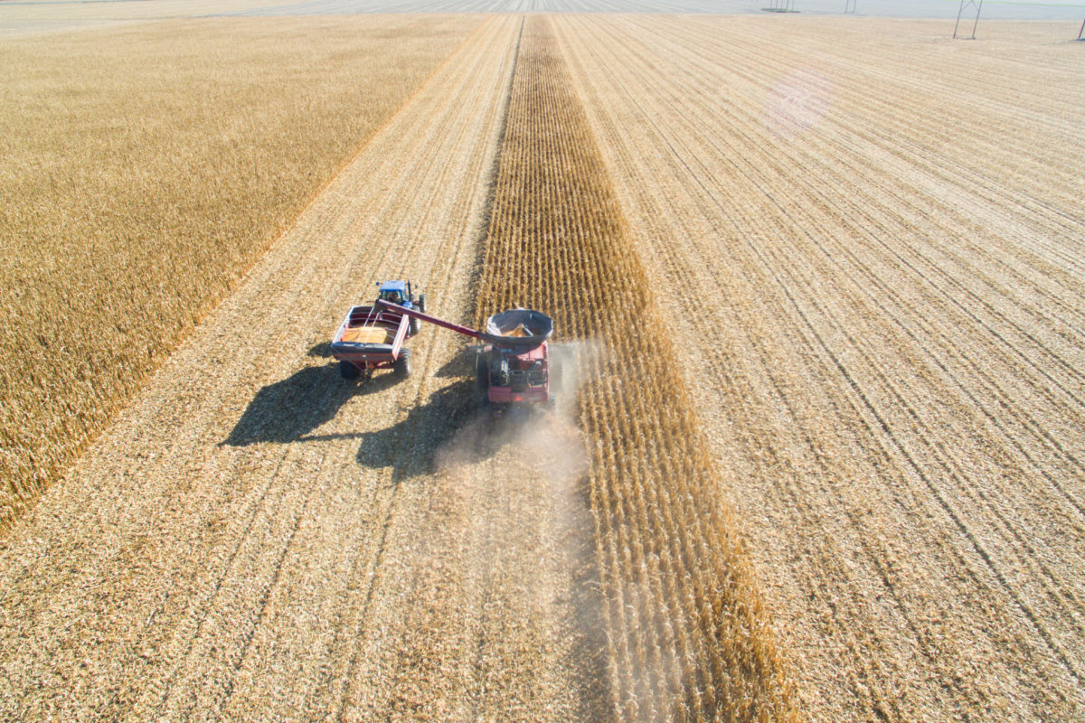
Soil
The quality of the crops is dependent on the quality of the soil.
Most of the soil used in big agriculture today is greatly depleted of minerals, due to intensive farming, lack of crop rotation and insufficient fertilizer.
Only 3 of over 50 required minerals are restored: N P K
Nitrogen
Phosphorus
Potassium

Slide 50
Soil
Without sufficient minerals, not only are crops less nutritious; they are also weaker and are more prone to being infested with fungi and insects.
The use of pesticides and fungicides is only really necessary when the soil and therefore the plants are of poor quality.
Using traditional farming methods, which rotate crops often, allow the ground to rest and also restores minerals to the earth, it is possible reduce and even eliminate the use of chemicals.
Although we are told that it is safe to use pesticides, more and more evidence is accumulating to show that there are adverse, even serious side effects associated with the use of such chemicals, including birth defects and even an increased risk of certain cancers.
Not long ago we were told that tobacco was not only safe, but it was even beneficial for things like asthma and bronchitis
Taste – vegetables and fruit grown in soil which is rich in minerals is tastier. The taste buds can detect the presence of minerals in the food.

Slide 51
Minerals & Taste
Taste – vegetables and fruit grown in soil which is rich in minerals is tastier. The taste buds can detect the presence of minerals in the food.
Remember how the strawberries and tomatoes your grandparents used to grow in their garden tasted?
Having a preference for tastier fruits and vegetables, in other words, those which are richer in nutrients, is advantageous in the wild, as it guarantees the consumption of the best foods, thus promoting better physical health and maximizing chances of survival.

Slide 52
Minerals & Taste
A lot of conventional produce today is lacking in taste
People of a certain age, who remember how fruit and vegetables used to taste, often complain about this fact
In order to compensate for the lack of taste, it is common practice to use extra salt, flavourings and even flavour enhancers. This is especially common in restaurants and in packaged food.
Unfortunately, excess table salt is not healthy and a lot of flavor enhancers can disrupt the balance of glutamate and GABA and in susceptible individuals, this can lead to increased restlessness, anxiety and even hyperactivity, ADHD and depression.

Slide 53
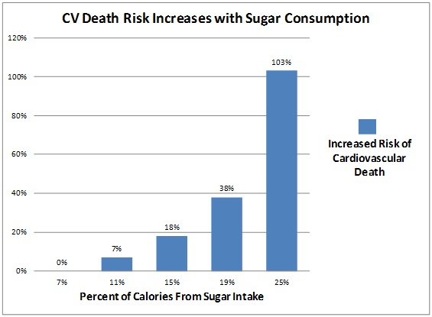
Sugar – The Silent Killer
Fat is demonized, but the dangers of sugar are underplayed.
The connection between sugar consumption and diabetes is well established, however the latest research shows a strong correlation between sugar consumption and chronic inflammatory diseases, including heart disease and cancer.

Slide 54
Sugar – The Silent Killer
Why is sugar so toxic?
Insulin – the consumption of refined sugars causes a massive fluctuation in insulin and in blood sugar. This has a profoundly destabilizing effect on their entire endocrine system leading to a yoyoing of energy levels and mood
Refined sugars causes massive amounts of free radical damage to our cells, damaging DNA and aging us prematurely
The consumption of refined sugars put stress on our adrenal glands and precipitate burnout and exhaustion in susceptible individuals
Sugar causes minerals to leach from the body, increasing the risk of tooth decay and osteoporosis
Sugar consumption has also been linked to inflammation, including inflammation of the brain, which in certain individuals can exacerbate existing psychiatric illnesses
Sugar consumptions feeds yeasts and fungi in the body, leading to increased risk of thrush, candida and a weakened immune system

Slide 55
Do I Have To Give Up Everything I Love?
It’s all about balance
It’s much more about what you do eat than what you don’t eat
It’s better to avoid eating refined sugars on an empty stomach and on their own.
Eat some fiber and some fat to slow down the absorption of sugar, therefore curbing insulin release and stabilising blood sugar

Slide 56
Do I Have To Give Up Everything I Love?
Opt for natural sources of sugar over refined sugar
Consume more protein at breakfast and lunch time to reduce the chances of unstable blood sugar and cravings later in the day
Consumption of sugars and carbohydrates in the morning sets you up for a roller coaster ride of highs and lows all day
Eating carbohydrates in the evening is better for hormone balance and promotes better sleep
Train your pallet to become accustomed to less sugar. Over time, things will taste just as sweet.
Bake your own cakes and biscuits and use excellent quality ingredients. Not only will it taste better, but it’s better for you
Eat as much chocolate as you like. It’s full of antioxidants (polyphenols) and its consumption is associated with a reduced risk of heart disease and even some cancers.
80/20 rule. Focus eating as well as you can for 80% of the time and don’t worry too much about the other 20%

Slide 57
Nutritional Supplements
Are they necessary? Most people will do fine without them, however they could do even better with them
Those who have symptoms of fatigue, burnout, inflammation or any other chronic condition can almost certainly benefit from supplementation
If we lived in a pristine world without pollution, without stress and where the food was grown in mineral rich soil, we would be able to get all the nutrients we need from the soil
Today, our reality is far from that. Sensible supplementation using high quality supplements can make a tremendous difference to our health and wellbeing
There are many poor quality supplements out there that do more harm than good

Slide 58
Summary
Micronutrients in food are essential for proper biochemistry
More and more evidence suggests a strong correlation between diet and the risk of major diseases
Fat – we may have it all wrong
Sugar – likely to be far more toxic than we used to think
Conventional versus organic produce
You don’t have to give up everything you enjoy
You may want to consider supplementation

